Slide 1


Customer ratings analysis and insights of webscraped data
25-08-2023

Slide 2
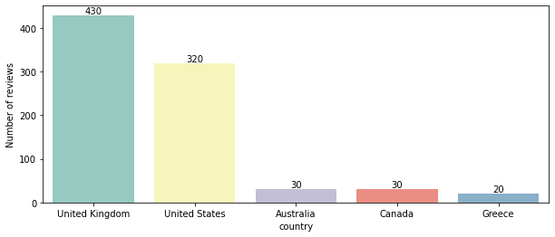
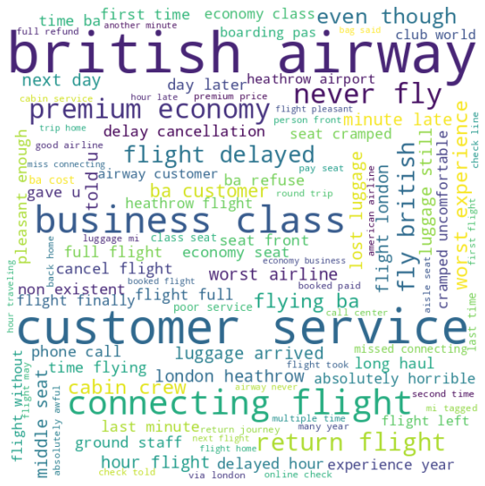
Insights
- Dissatisfied by the frequent flight delays, connecting flights, and flying hours.
- Other issues from the cloud image, like crammed seats, misplaced bags and poor customer service.
- Regular customers appear to be unsatisfied, which raises the question of whether our service is cost effective.
Out of 1000 reviews, 420 were positive, 570 were negative
and 10 were neutral.
Word cloud of keywords used in reviews

